Slide 1
16-Steps Sequencer and Synthesizer
Zhuowen Lin & Jinyue Guo
11510818 & 11510478
Information Engineering, SUSTech

Slide 2
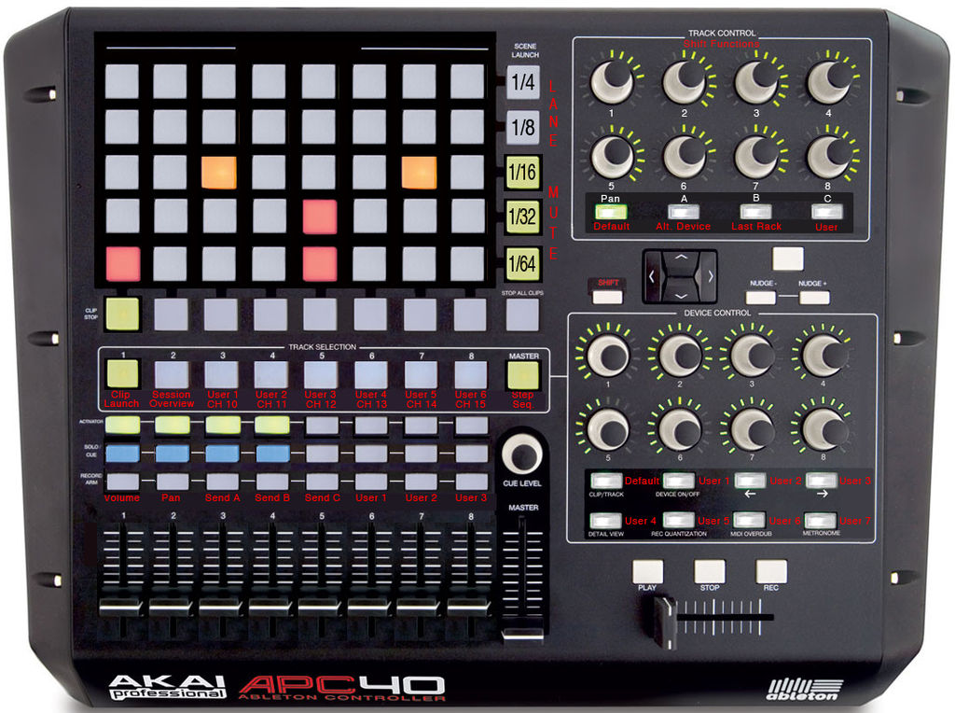
Speech Outline
Inputs & Outputs
Components of the circuit
Result demonstration
Further enhancements

Slide 3
Inputs & Outputs

Slide 4
Inputs
Switches
Each of the 16 switches is assigned to a note at a specific time.
When the time passes it, a note of the selected frequency will play.
Buttons
BTNR: Save: assign any switch that is in the on position with the current frequency.
BTNU: Switch frequency: rotate through the 16 frequencies.
BTNC: Play/Pause
BTNL: Reset: erase all assigned tones.

Slide 5
Outputs
LEDs
LEDs above each switch.
Light up when a tone is playing on that particular switch.
Seven Segment Display
Show which frequency is being worked with.
Rotate from 0 to F.
Speaker
Sound wave at different frequencies.

Slide 6
Components of the Circuit

Slide 7
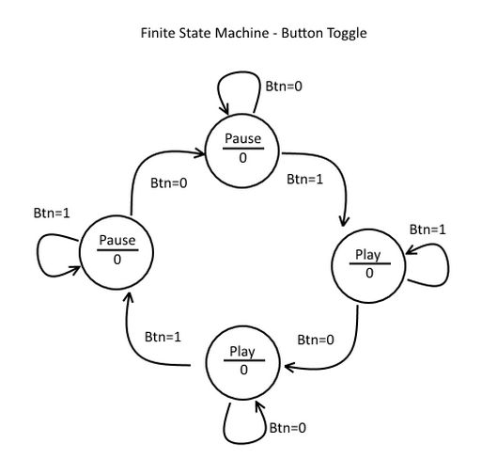
Button Toggle – Play & Pause
FSM
Toggle between two states exactly one time when the button is pressed

Slide 8
Button Debouncer
Button bounce
Switch between states in FSM
Debouncer
By Scott Larson of Digi-key
10.5 ms stable input time

Slide 9
Clock Dividor – BPM setting
Convert 100 MHz to lower frequencies
Used to set BPM

Slide 10
Counter – Tone / Switch Tracker
Keep track of the tone
Speaker knows which tone to be played
Seven segment display knows which number to be displayed
Keep track of the switch
Speaker knows which switch position to be played
Counter increasing speed: BPM
T flip-flop
4 bits ←→ 4 T flip-flops
Least significant bit: toggle each time
The other bits: toggle when all of bits below them are equal to one.

Slide 11
D Flip-Flop
Remember the tone of 16 switches

Slide 12
Seven Segment Display
Course Lab 3
Hexadecimal number

Slide 13
Square Wave Generator
Change frequency dividing factor
Number | Tone | Max Count
0 | 0 | 0
1 | a | 227272
2 | c1 | 191114
3 | d1 | 170262
4 | e1 | 150372
5 | g1 | 127552
6 | a1 | 113636
7 | c2 | 95556
Number | Tone | Max Count
8 | d2 | 85131
9 | e2 | 75843
10 | g2 | 63776
11 | a2 | 56818
12 | c3 | 47778
13 | d3 | 42566
14 | e3 | 37922
15 | g3 | 31888

Slide 14
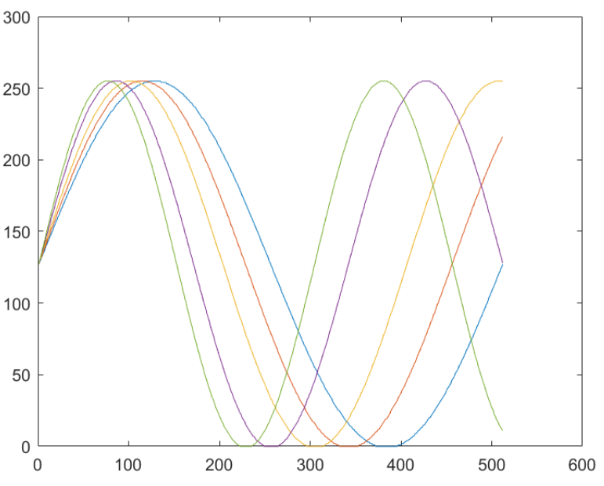
Sine Wave Generator
Waveform dictionary
512-length arrays
Respective frequencies
Value loader
Index: read value
Different max values

Slide 15
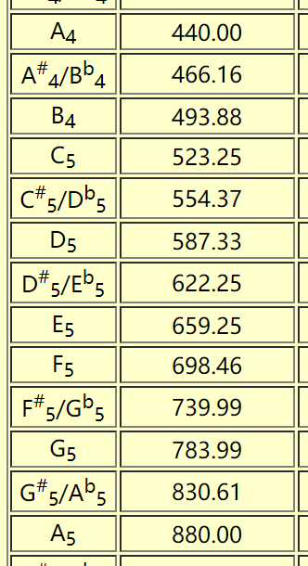
Sine Wave Generator - frequency
Octave freq. divider
Save memory space
Use only Five distinct dictionaries
Physical freq. divider
Divides oscillator clk into real sine wave clk

Slide 16
Sine Wave Generator - Structure
Input:
Clk: std_logic
Tone: std_logic_vector (3 downto 0)
Output:
Wave_out: std_logic_vector(7 downto 0)
Waveform dictionary
Physical freq. divider
Pre-loader
Input tone (4bit)
Load dictionary
Maximum index
Octave div coefficient
Octave freq. divider
Output value loader

Slide 17
Sine Wave Generator - Structure
Why having two freq. dividers?
Separate the waveform generating process
Easier to create new dictionaries

Slide 18
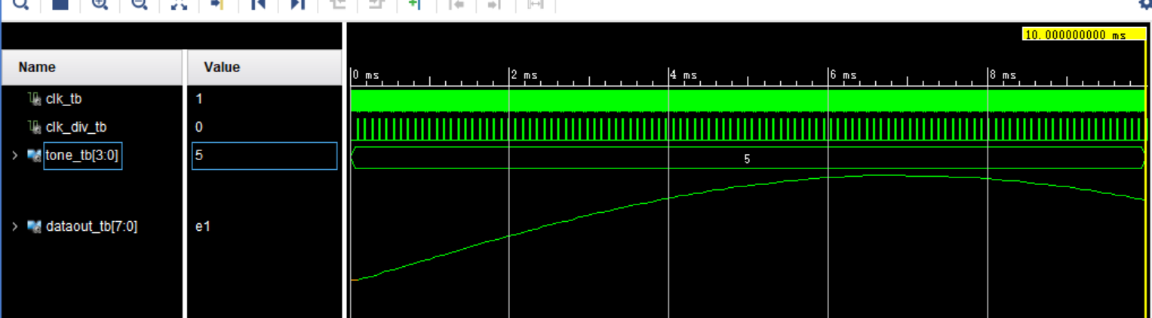
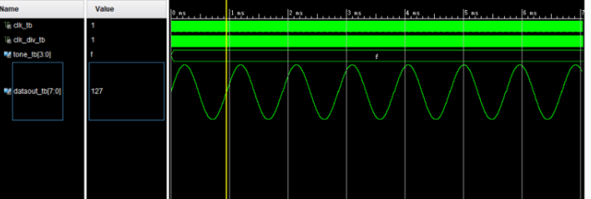
Sine Wave Generator

Slide 19
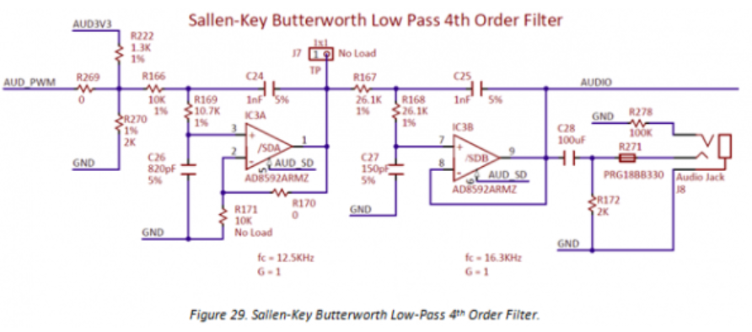
PWM Encoder
Nexys 4 DDR has a built-in PWM (Pulse Width Modulation) decoder, which is a low-pass filter.

Slide 20
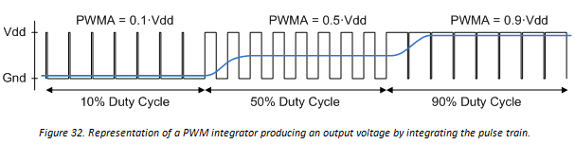
PWM Encoder
Input: wave_in : std_logic_vector (7 downto 0)
Calculate Duty Cycle threshold, according to PWM frequency
Counter: smaller than threshold, output ‘1’; else ‘0’
Output: std_logic

Slide 21
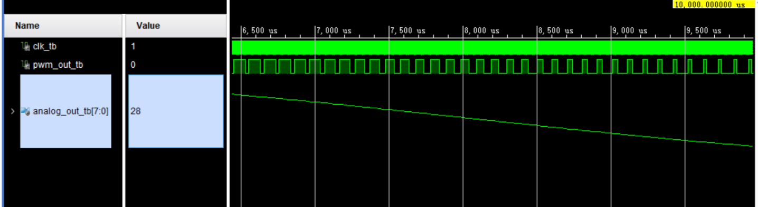
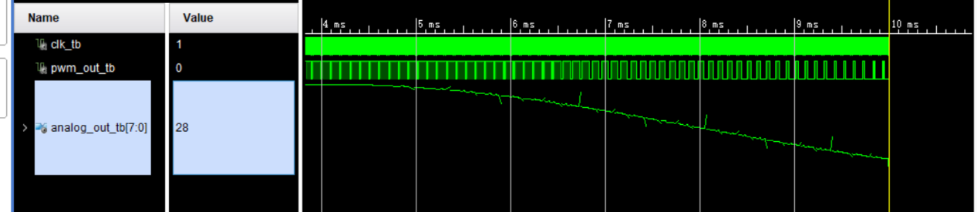
PWM Encoder

Slide 22
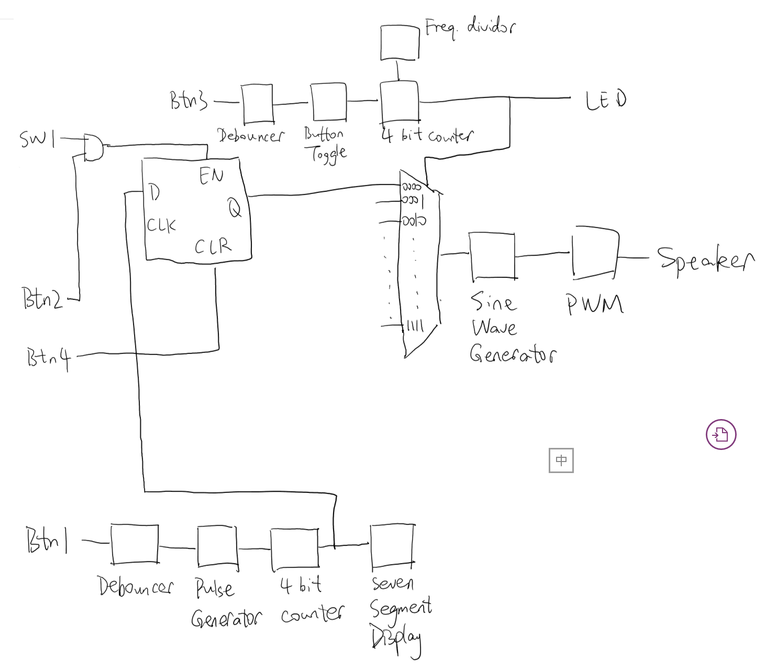
Connecting Components

Slide 23
Result Demonstration

Slide 24
Further Development
Better volume/ DA output solution
Beats synthesizer
Synchronization ports
Selectable timbre (square, sine, toothsaw, etc.)
Changeable BPM

Slide 25
Reference
Frequencies for equal-tempered scale, A4 = 440 Hz http://pages.mtu.edu/~suits/notefreqs.html
Nexys 4 DDR Reference Manual https://reference.digilentinc.com/reference/programmable-logic/nexys-4-ddr/reference-manual
PWM Audio Tutorial using a FPGA https://www.youtube.com/watch?v=4byHVqXD-UI
Class Slides

Slide 26
Q&A

Slide 27
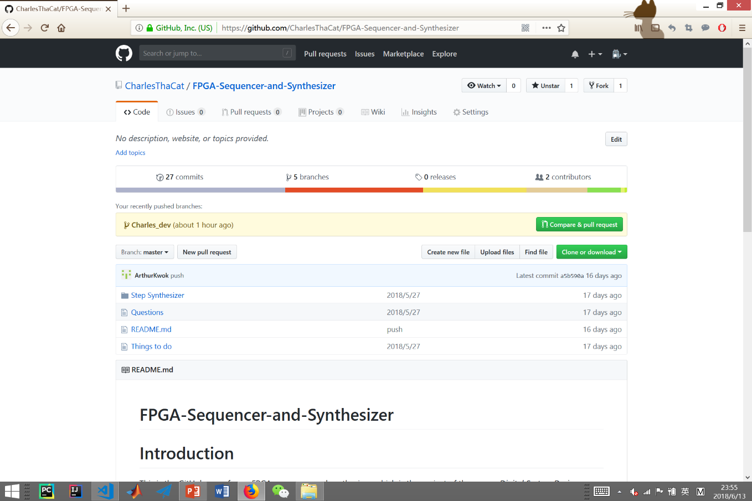
GitHub Page
https://github.com/CharlesThaCat/FPGA-Sequencer-and-Synthesizer

Slide 28
Thank You!

